Slide 1
Parallelization of Linear Regression
Submitted to: Dr. Manish Kumar Bajpai
Prepared By:
K Avinash Reddy (2011251)
Vellanki Anish (2011264)

Slide 2
Introduction
In statistics, linear regression is an approach for modeling the relationship between a scalar dependent variable y and one or more explanatory variables (or independent variable) denoted by X.
The case of one explanatory variable is called simple linear regression. For more than one explanatory variable, the process is called multiple linear regression.
In linear regression, data are modeled using linear predictor functions, and unknown model parameters are estimated from the data. Such models are called linear models.

Slide 3
Introduction
Most commonly, linear regression refers to a model in which the conditional mean of y given the value of X is an affine function of X.
Less commonly, linear regression could refer to a model in which the median, or some other quantile of the conditional distribution of y given X is expressed as a linear function of X.
Like all forms of regression analysis, linear regression focuses on the conditional probability distribution of y given X, rather than on the joint probability distribution of y and X, which is the domain of multivariate analysis.

Slide 4
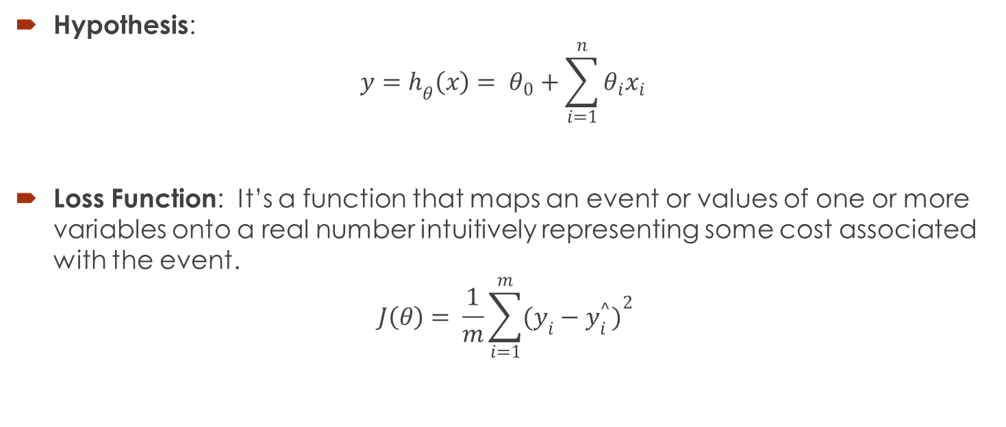
Terminology
Hypothesis:
$${y=h}_{θ}\left(x\right)= θ_{0}+\sum_{i=1}^{n}{{θ_{i}x_{i}}^{ }}$$
Loss Function: It’s a function that maps an event or values of one or more variables onto a real number intuitively representing some cost associated with the event.
$$J\left(θ\right)= \frac{1}{m}\sum_{i=1}^{m}{{(y_{i}−y_{i}^{^})}^{2}}$$

Slide 5
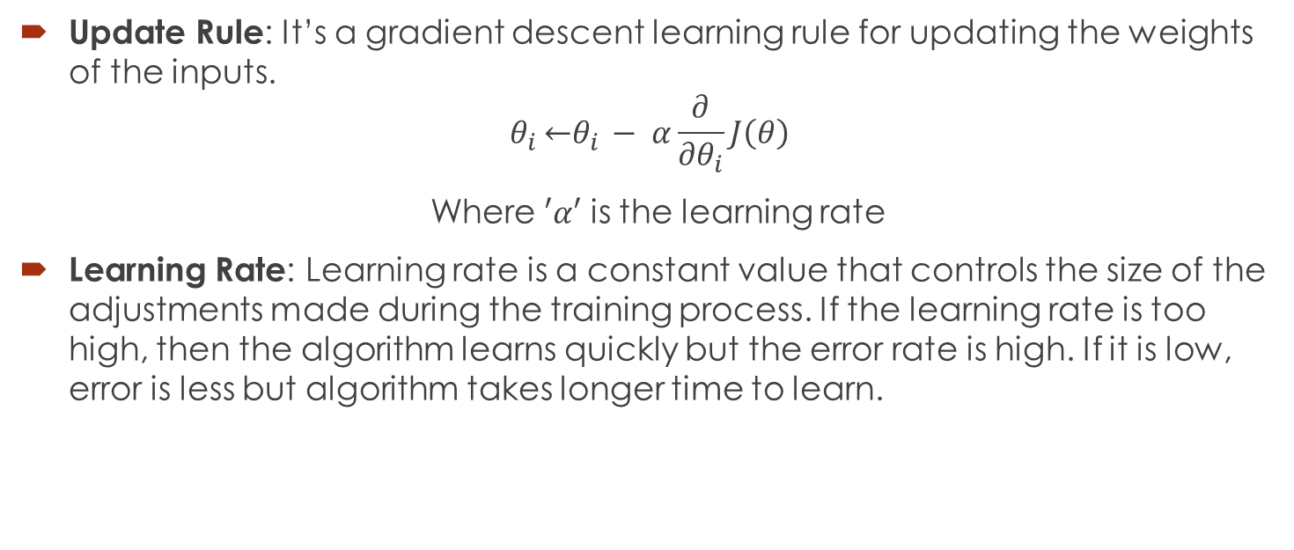
Terminology
Update Rule: It’s a gradient descent learning rule for updating the weights of the inputs.
$$θ_{i }\underset{←}{ }θ_{i }− α\frac{∂}{{∂θ}_{i}}J\left(θ\right)$$
Where $′α′$ is the learning rate
Learning Rate: Learning rate is a constant value that controls the size of the adjustments made during the training process. If the learning rate is too high, then the algorithm learns quickly but the error rate is high. If it is low, error is less but algorithm takes longer time to learn.

Slide 6
Serial Algorithm
LinearRegression(data[],gradient)
INPUT: data[]
OUTPUT: gradient
BEGIN
FOR every a and b loop until converge
errors = 0
FOR i = 1 to data.length
fx = a * data[i] + b
errors += (fx - labelData[i]) * data[i]
END FOR
gradient = gradient - learningRate * 1/data.length * errors
END FOR
END

Slide 7
Parallel Methodology
Machine learning problems become computationally expensive when the no of features increase and/or when the amount of data increases.
Especially on big data sources with hundreds of millions of samples, the time to run optimization algorithms increases dramatically.
That’s why we are looking for parallelization opportunities in the algorithms
The error summation of gradient descent algorithm is a perfect candidate for parallelization.

Slide 8
Parallel Methodology
We could split the data into multiple parts and run gradient descent on these parts in parallel.
We are using PRAM model with the help of OpenMP framework in C language.
With the help of work sharing constructs used to split up loop iterations and other OpenMP clauses like Synchronization, scheduling, reduction, we will try to parallelize the gradient descent algorithm for linear regression.
This could decrease the run time of the algorithm for large data sets.

Slide 9

PRAM Algorithm
ParallelLinearRegression(data[],gradient)
INPUT: data[]
OUTPUT:gradient
BEGIN
FOR i=0 to p-1
P_{sum}[i] = 0;
END FOR
DO IN PARALLEL FOR ALL Processors P_{j} 0$≤$j$≤$p-1
FOR every a and b loop until converge
errors = 0
FOR i = 0 to $\left(\frac{data.length}{p}−1\right)$
fx = a * data[j*$\left(\frac{data.length}{p}\right)$ + i] + b
P_{sum}[j] += (fx - labeldata[j*$\left(\frac{data.length}{p}\right)$ + i] * data[j*$\left(\frac{data.length}{p}\right)$ + i]
END FOR

Slide 10

PRAM Algorithm contd….
FOR i=0 to p-1
errors = errors + P_{sum}[i]
END FOR
gradient = gradient - learningRate * ($\frac{1 }{data.length})$* errors
END FOR
END

Slide 11
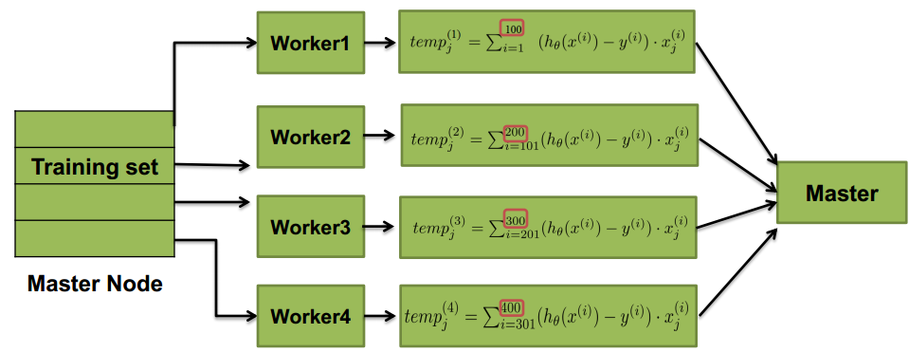
BSP Methodology
Master node divides the iterations equally to slave nodes
Each slave calculates its temporary gradient back to the master node.
Master node dividing data to slaves

Slide 12
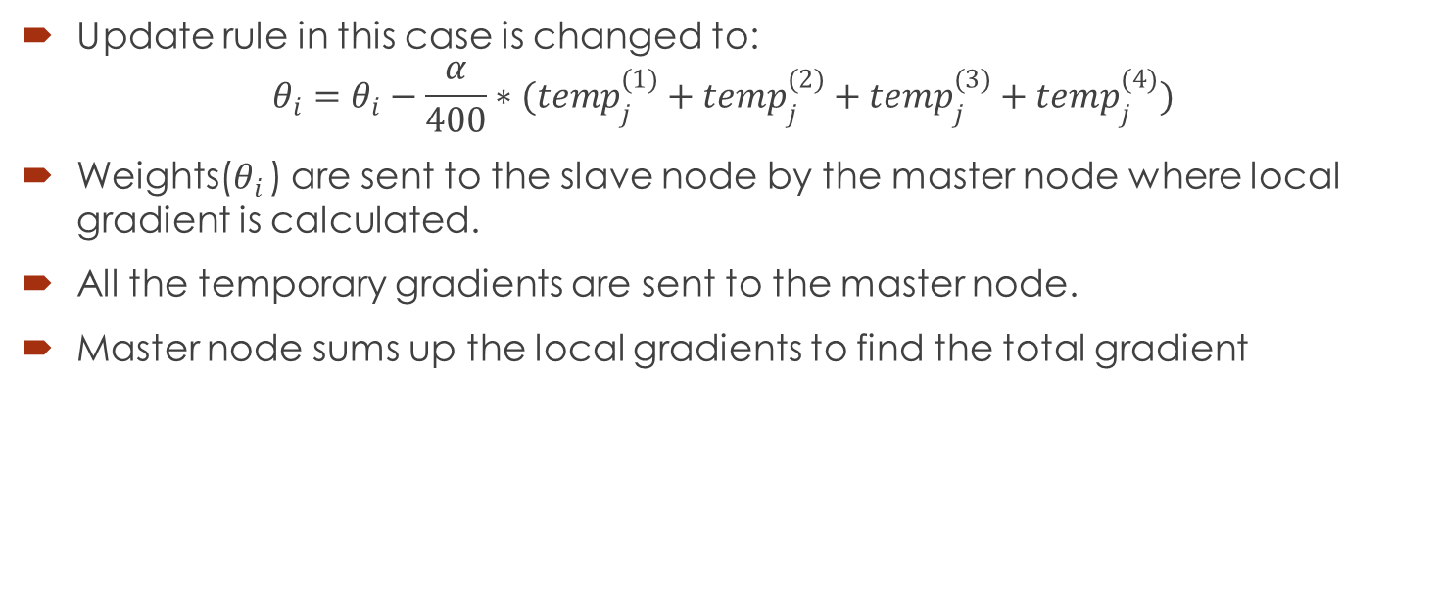
BSP Methodology
Update rule in this case is changed to:
$$θ_{i}=θ_{i}−\frac{α}{400}∗({temp}_{j}^{(1)}+{temp}_{j}^{(2)}+{temp}_{j}^{(3)}+{temp}_{j}^{(4)})$$
Weights($θ_{i }$) are sent to the slave node by the master node where local gradient is calculated.
All the temporary gradients are sent to the master node.
Master node sums up the local gradients to find the total gradient

Slide 13
BSP Algorithm
Linear Regression(data[],gradient)
INPUT: data[]
OUTPUT: gradient
BEGIN
MASTER NODE DO
FOR i=0 to p
temp[i] = 0
END FOR
FOR i=0 to n/p
P_{j}[i] <= data[j*n/p +i]
temp_{j} <= 0
END FOR

Slide 14

BSP Algorithm contd…
DO IN PARALLEL FOR PROCESSORS P_{j} 0$≤$j$≤$p-1
FOR every a and b loop until converge
errors = 0
FOR i = 1 to P_{j}.length
fx = a * P_{j}[i] + b
errors += (fx - labelData[i]) * P_{j}[i]
END FOR
temp_{j} = temp_{j} - learningRate * 1/P_{j}.length * errors
END FOR
temp[j] <= temp_{j}
END PARALLEL
MASTER NODE DO
FOR i=0 to p-1
gradient += temp[i]
END FOR
END

Slide 15
Results
We performed our program on Intel(R) Core i7-2670QM CPU Quad Core (No. of threads=8) with 2.20 GHz clock speed and 6GB main memory.
S.no | Data Set Name | Data Set Size (No. of rows, No. of Attributes) | Runtime for Serial Algorithm | Runtime for Parallel Algorithm | Speedup
1 | Seeds | 210, 7 | 1.3 sec | 2.2 sec | 0.59
2 | Yacht Hydrodynamics | 308, 7 | 2.1 sec | 2.8 sec | 0.75
3 | Car Evaluation | 1728, 6 | 8.3 sec | 4.73 sec | 1.75
4 | Abalone | 4177, 8 | 12.56 sec | 5.89 sec | 2.13
5 | Page Blocks Classification | 5473, 10 | 19.92 sec | 7.12 sec | 2.79

Slide 16
Results
Comparing Runtimes for different datasets

Slide 17
References
Linear Regression wiki link: http://en.wikipedia.org/wiki/Linear_regression#Other_estimation_techniques
Gradient Descent wiki link: http://en.wikipedia.org/wiki/Gradient_descent
Machine Learning by T. Mitchell
Data Set Link: http://archive.ics.uci.edu/ml/datasets.html

Slide 18
THANK YOU

